Slide 1

PowerEnJoy
A new way of doing car sharing

Slide 2

Topics
Problem analysis
Status of the market
System to be
Goals & Requirements

Slide 3
Problem analysis
We manage to design and develop a digital management system for a car-sharing service that exclusively employs electric cars
Why electric cars only?
Because big cities are already experiencing high levels of pollution, and their citizens are looking for a new way to move that may be, at the same time, cheaper and green.

Slide 4
Problem analysis
The system will allow registered users to discover available cars nearby their current position
Registered users will be allowed to book a car for a limited time (1 hour)
Within this time, the user will be allowed to delete his/her reservation
The user will be asked to pay a fee of 1 euro if the reservation expires
After a reservation is concluded or expired, the reserved will become available for other users
The system will incentivize the virtuous behaviors of the users by means of applying discounts or fees in the appropriate contexts.

Slide 5
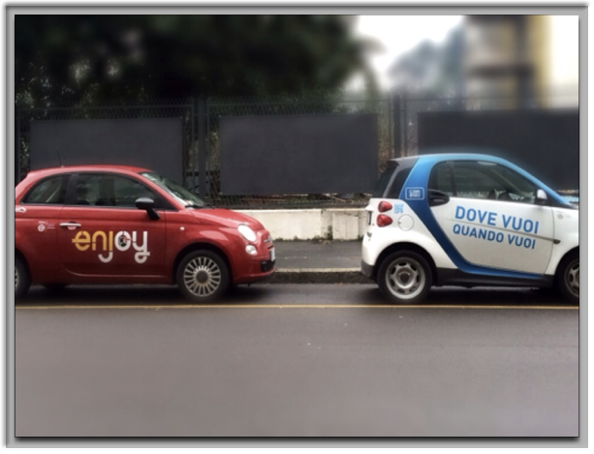
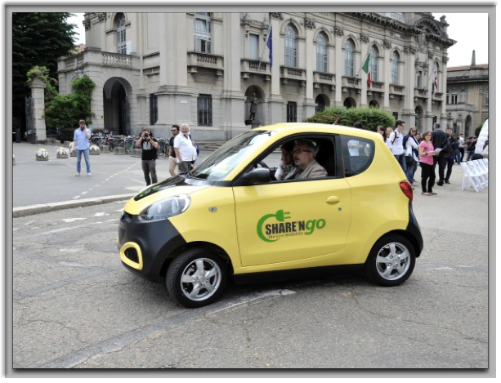
Status of the Market
Only in the city of Milan there are approximately:
6 car sharing services involving only vehicles with combustion engines
3 car sharing services involving only electric vehicles

Slide 6
Placeholder --- prima parte

Slide 7
Architecture
The PowerEnJoy system is designed with a modified MVC approach:
The Model is in the Business Manager
Multiple Controllers manage multiple aspects of the system
User Controller
Car Controller
Payment Manager
Administration Helper

Slide 8
Architecture
The PowerEnJoy system is designed with a modified MVC approach:
The Customer View is implemented:
in the Mobile App
on the car system
The Administration View is offered by the server as a web application (thin client approach)

Slide 9
Architecture: the car subsystem
The car subsystem consists of:
The Car Manager: part of the Business Manager (Model)
The Car Controller: handles communication with the cars
The Cars themselves as their cyber-physical systems

Slide 10
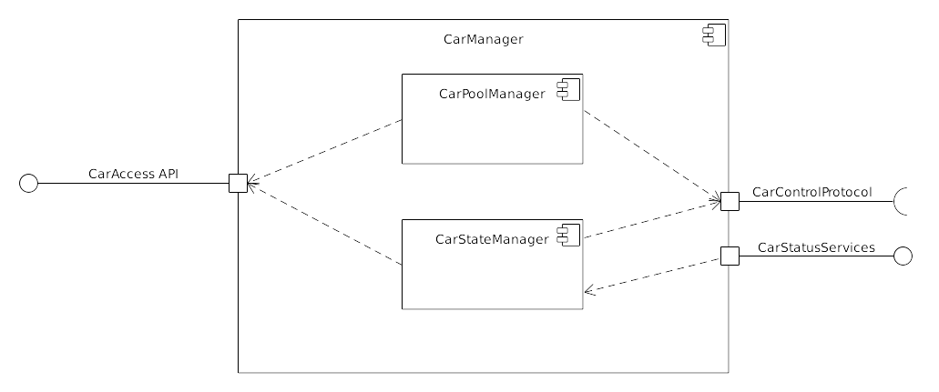
Architecture: the Car Manager
Part of the Business Manager
Performs all DB operations regarding:
Car state handling (Car State Manager)
Subscription or deletion of cars to the system (Car Pool Manager)
Answer queries on car sets issued by the user

Slide 11
The Car communication protocol
Cars will interact with the server’s Car Controller in the following ways:
Authentication to the server
Ordinary communication
Events: state changes originating from the car
Commands: state changes issued to the car by the server
Ordinary telemetry: regular messages to update the server about the car general condition (position, battery status...)

Slide 12
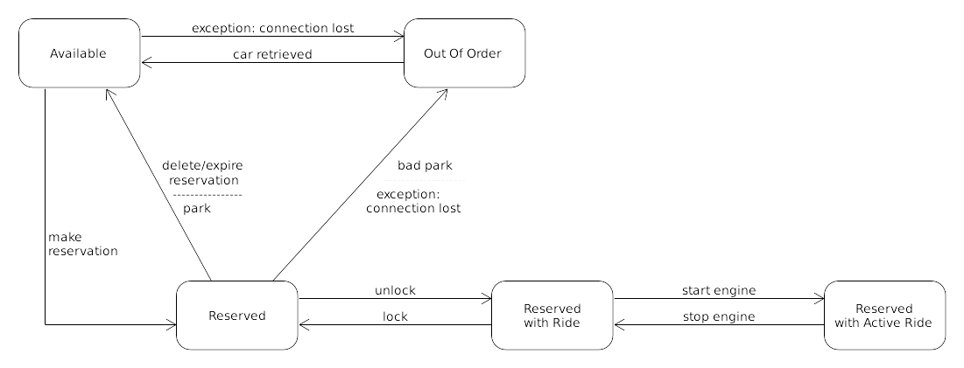
The Car as a FSM

Slide 13
The Car as a FSM
State changes issued by the server (commands):
Reserve: an available car becomes reserved
Free: a reserved car becomes available
Invalidate: a reserved car is parked in an unreachable spot and becomes Out Of Order
Unlock: the user has pressed the unlock button on their phone, the reserved car now is Reserved With Ride
Retrieve: an Out Of Order car has been retrieved by personnel and becomes available again

Slide 14
The Car as a FSM
State changes originating from the car (events):
Lock: the user has closed and locked the car door after a ride, the car state changes from Reserved With Ride to Reserved
Start engine: the car state changes from Reserved With Ride to Reserved With Active Ride
Stop engine: the car state changes from Reserved With Active Ride to Reserved With Ride

Slide 15
Title
Text

Slide 16
Cost estimation
Approach
We used the Function Point method together with COCOMO II to estimate the project’s effort and duration
We computed every estimation twice, to get a lower bound and an upper bound for all estimates

Slide 17
Cost estimation
Results
Lower bound
Upper bound
UFP = 50
KSLOC = 5.2
Effort = 18.32 person-months
Duration = 9.3 months
UFP = 70
KSLOC = 7.28
Effort = 26.54 person-months
Duration = 10.4 months

Slide 18
Title
Text

Slide 19
Risk evaluation
Business risks
Implementation behind schedule
Loss of application data
User data leaks

